Slide 1
The Greeks
c. 510 B.C.E. to 360 B.C.E.
Also known as
The Classical Period
The Helenic Period

Slide 2
Origins of Greek Society
The ideas of civilized life spread eastward and westward from Egypt and Mesopotamia.
The Minoan Civilization on the Island of Crete traded with the Egyptians and Mesopotamians.
Mycenaeans also interacted with the Egyptians and Mesopotamians.
The Mycenaeans conquered the Minoans and overtime, they intermarried and became the Greeks.

Slide 3
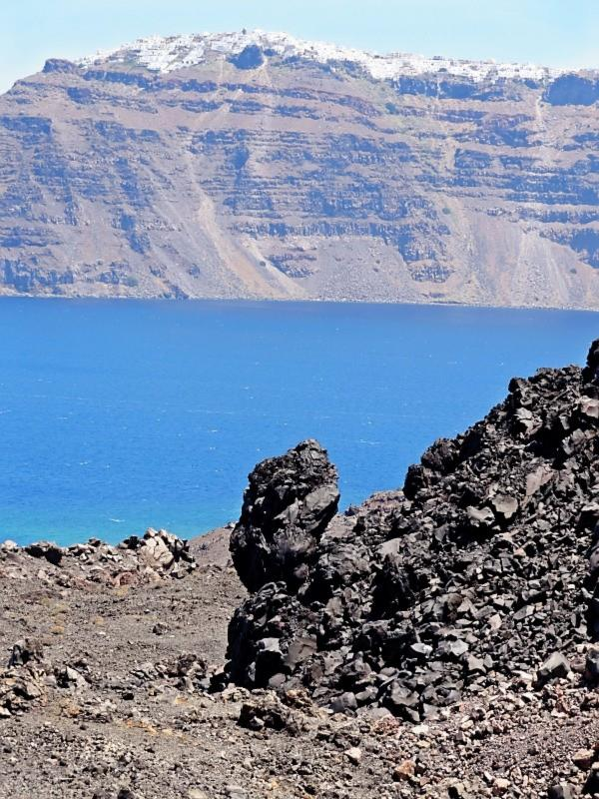
Geography
Balkan Peninsula
Mediterranean Sea
High rugged, mountains
How might the geography impact government?
20% of land is fertile enough to farm
No major river or river valley
How might this
impact the economy?

Slide 4
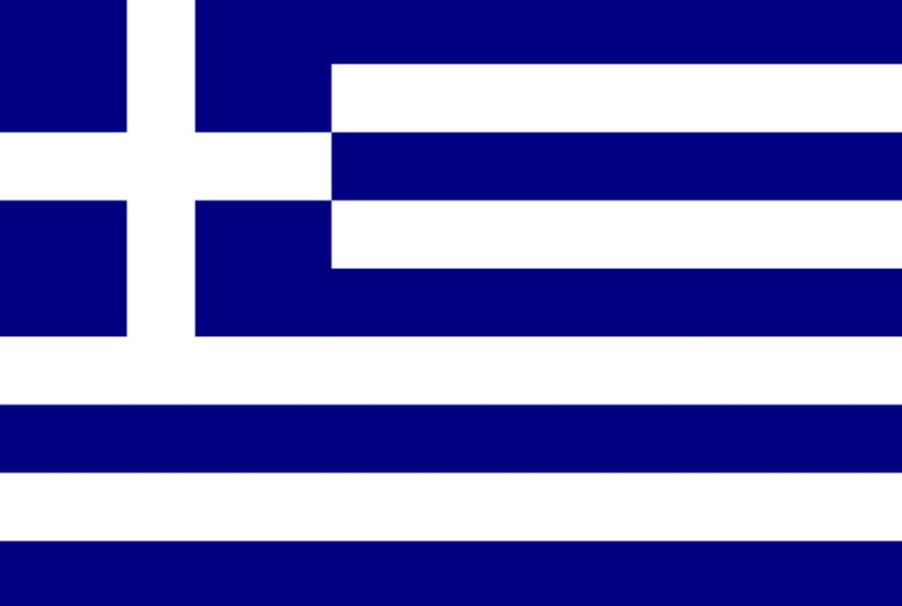
Greek City States
Polis- a Greek city state that served as a center for Greek social, political, and economic life.
Each city state was independent from the others, but there were some similarities.
Greece, as we know it today, did not become a country until 1829.

Slide 5
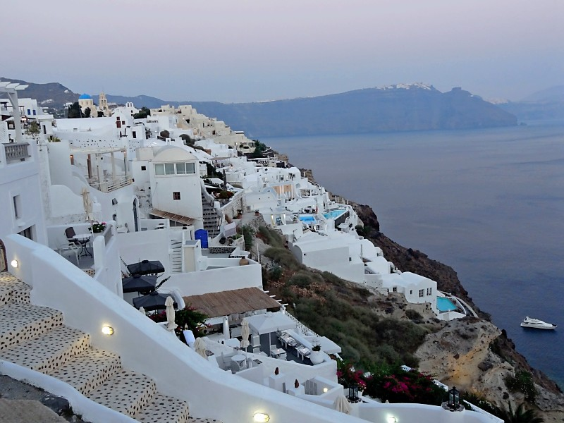
Common Characteristics for Ancient Polis
50-500 square miles
On average, each polis was home to 10,000 people.
Citizens were land-owners who had all the power (economic, government, etc)
Non-citizens were non-land owners.

Slide 6
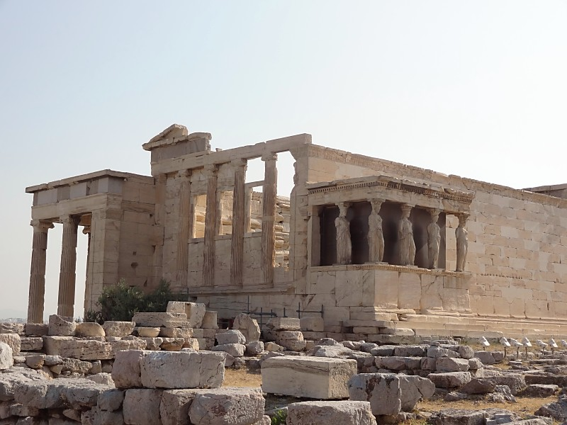
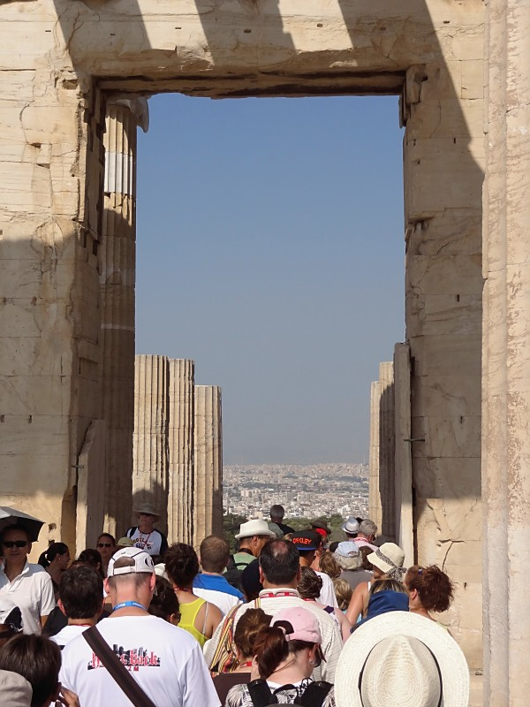
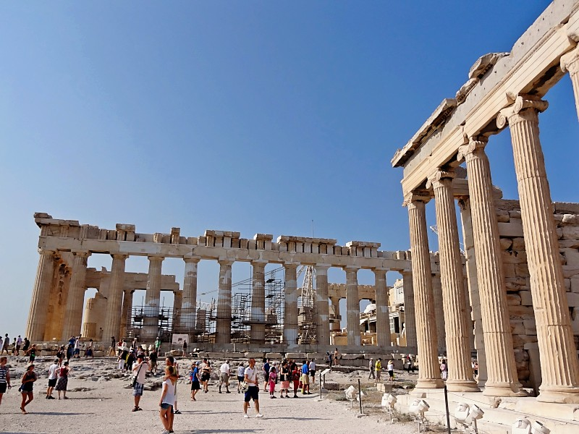
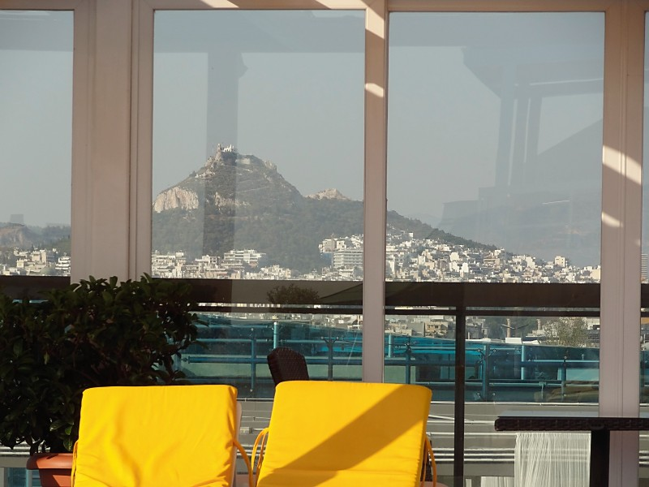
The Acropolis
In the Athens Polis
Fortified (surrounded by a wall and built on the highest mountaintop)
Ruins still stand today and it is one of the world’s most visited attractions

Slide 7
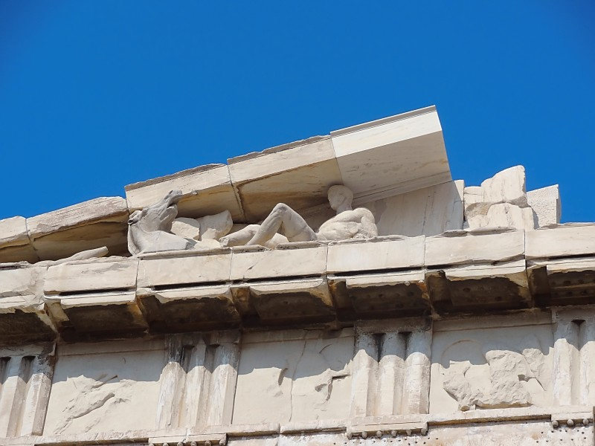
Inside the Polis
Temples (In the Athenian Acropolis, the most famous building is the Parthenon, a temple dedicated to Athena)

Slide 8
Inside the Polis
Agora- a marketplace
Aqueducts-system to transport water throughout the city-state
Gymnasium-get Olympic-ready
Theatre-inventors of drama
Chorea-farmland

Slide 9
Inside the Acropolis
Middle image: theatre
Others: remains of government buildings

Slide 10
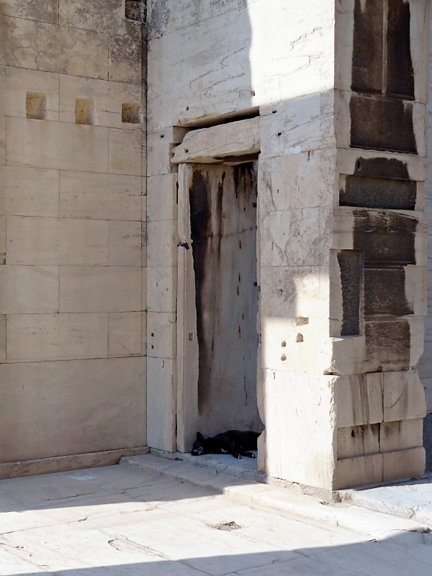
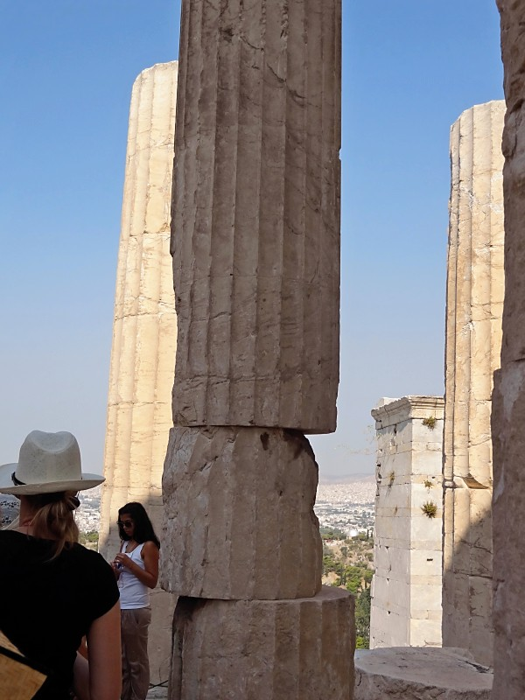
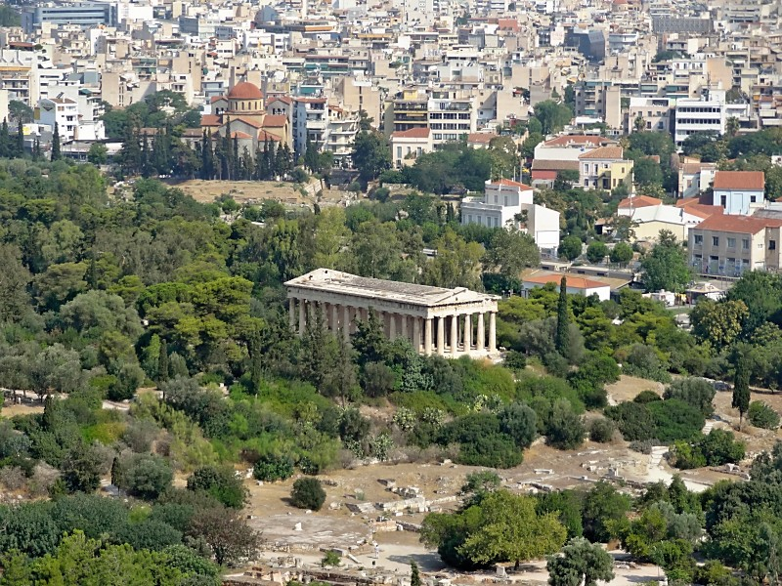
Inside the Acropolis Continued

