Slide 1
World Literature
From Dark to Light:
The Dark Ages to the Enlightenment

Slide 2
Dark Ages Enlightenment
Early Middle Ages: 5th to 11th Centuries AD
Time of intellectual and cultural “darkness” permeating Europe after fall of the Roman Empire
Few historical or written records- we are in “the dark”
Plague, war, stagnant culture
Rise of Christianity
Crusades aim to prevent spread of Islam
18th Century AD
Also known as The Age of Reason
Promoted science and intellectual discovery
Aimed to reform society
Fought intolerance, superstition, and abuse of power in the church (ex: witchcraft trials taking place throughout Europe)
Humanism emerges: by celebrating humanity, God’s creation, one is worshipping God

Slide 3
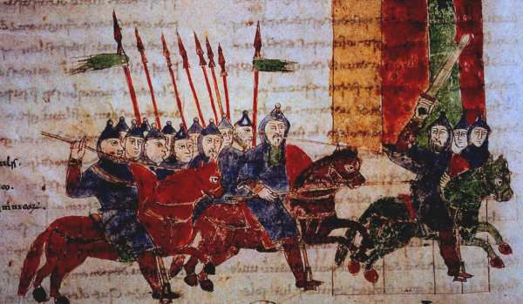
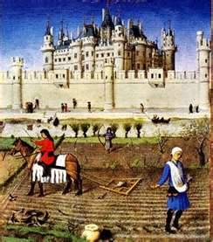
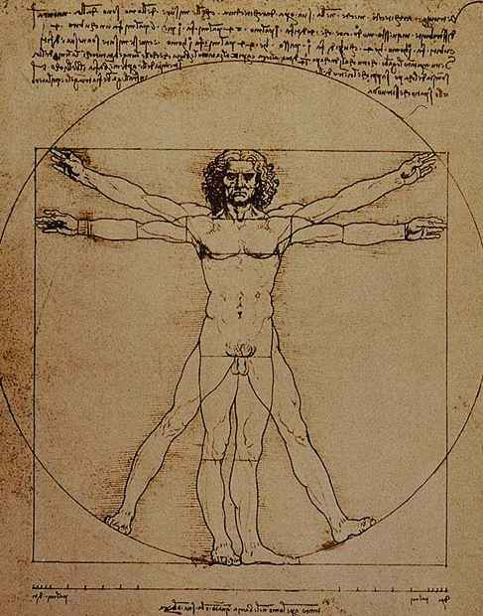
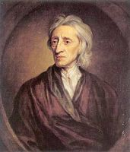
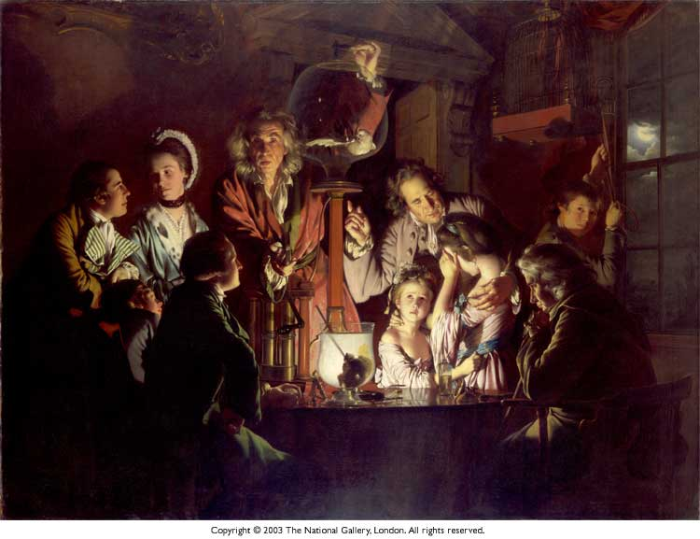
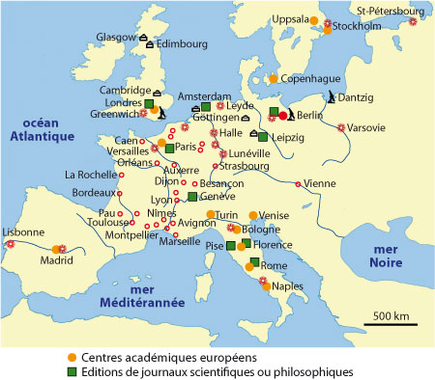
Dark Ages to Enlightenment
Top: Early Middle Ages, High Middle Ages, Davinci’s works during the Renaissance
Bottom: John Locke, The Age of Enlightenment, map of Europe

Slide 4
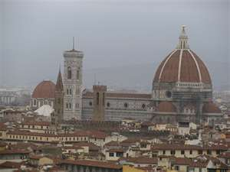
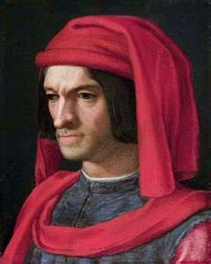
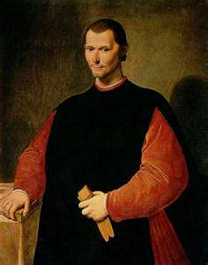
The Italian Renaissance
The Middle Ages End
1350-1550: Italians reexamine the culture of the Greeks and Romans, becomes known as rebirth, or renaissance
The Medici dynasty in Florence funds architectural projects and commissions Michelangelo to sculpt for the family
The Medicis also hire Niccolo Machiavelli.
Machiavelli writes The Prince, a book instructing rulers to be unencumbered by moral principles. To be a great ruler, one must let his/her “conscience sleep.”

Slide 5
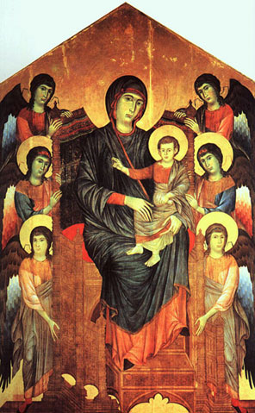
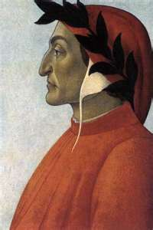
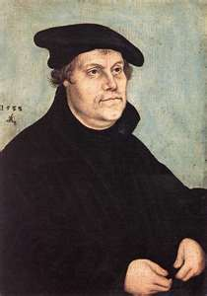
The Italian Renaissance Continued
Corruption in government and the Roman Catholic Church had long reaching ramifications.
Dante Aligheri- The Divine Comedy, the story of a soul’s journey to salvation
Protestant Reformation- Martin Luther
Humans could not be saved through good works or through the purchase of indulgences
Justification by faith alone

Slide 6
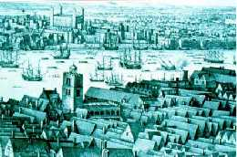
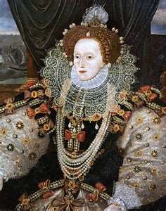
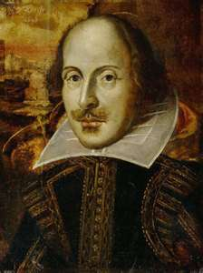
Elizabethan England
1558: Elizabeth Tudor ascends the
throne
Elizabeth repeals laws favoring Catholics; The Church of England becomes mostly Protestant
April 1564: William Shakespeare is born
Attending the theatre is a popular pastime when Shakespeare arrives in London (1592)
Shakespeare was a playwright, actor, and shareholder in the theatre company Lord Chamberlain’s Men
Queen is a theatre patron, but dramatists must keep her tastes in mind when writing plays

Slide 7
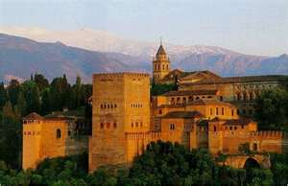
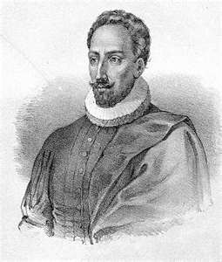
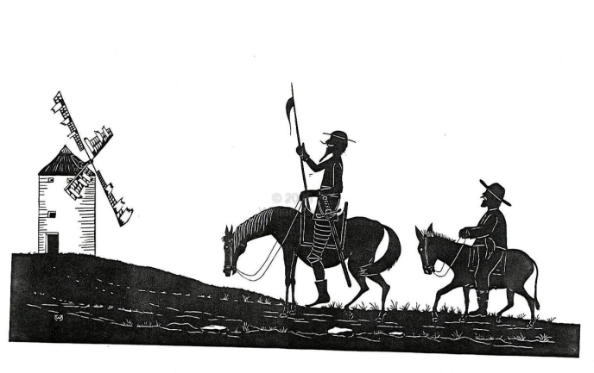
Spanish Literature
1500s considered a
“golden century” in Spain as well
Theatre popular in Seville and Madrid
Novel emerging art form
Miguel de Cervantes writes Don Quixote, the story of a excitable, impulsive knight and a pragmatic squire. The text shows that dreams and hard work are both necessary elements of the human condition.

