Slide 1
World Literature
Ancient Literature: Archetype, Allusion, and Myth

Slide 2
Terminology
Archetype-a pattern that occurs in stories from different cultures and times
Allusion-a passing or casual reference; an incidental mention of something, either directly or by implication: an allusion to Shakespeare.
Myth-a traditional story passed through generations that explains why the world is the way it is.

Slide 3
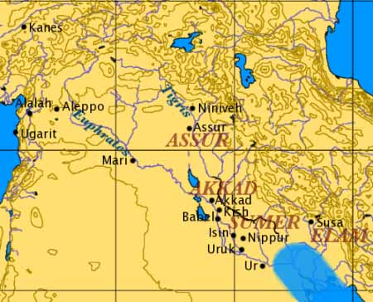
In the Beginning…. The Sumerians
Civilization begins in Mesopotamia 3000 B.C.
Located between the Tigris and Euphrates Rivers
Also known as The Fertile Crescent
People known as Sumerians
Formed city-states including Uruk
Believed gods ruled these cities, theocracy
Kings were thought to receive their powers from the gods

Slide 4
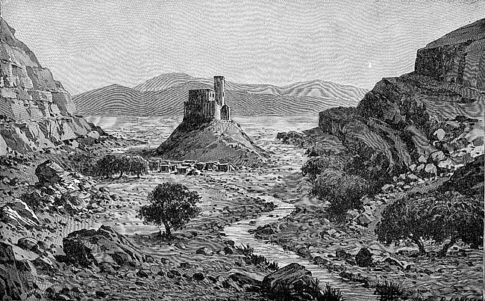
Sumerian cities were surrounded by walls made of mud and always included a temple dedicated to the chief god or goddess of the city.

Slide 5
Society Develops
Daily Life
A New Empire
People speak Semitic language
Agrarian Society
Some metalwork, pottery, and textiles
Invention of the wheel (3000 B. C.)
Patriarchal society
Three major social groups:
Nobles, commoners, and slaves
Akkadian empire rules until 1792 B.C.
Hammurabi, King of Babylon, creates a new Mesopotamian Empire
Hammurabi Code- system of strict justice with an emphasis on retaliation
Punishments vary by social status; laws also regulate marriages, public officials, and business transactions

Slide 6
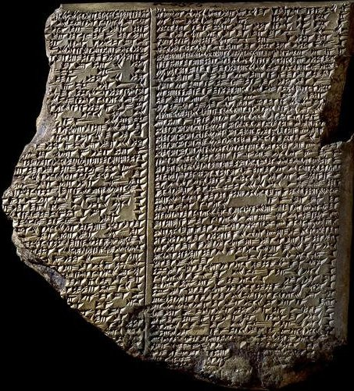
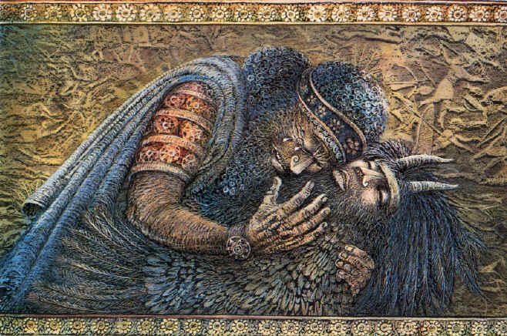
The Creativity of the Sumerians
Cuneiform system of writing developed in 3000 B.C.
Wedge-shaped impressions were made on clay tablets which were dried in the sun.
Upper class boys trained as
scribes
The Epic of Gilgamesh is the world’s
oldest epic poem.

Slide 7
The Mediterranean
Greece
Rome
750 B.C. – the polis, or city state, is the center of Greek life
City-states were built on hills and surrounded by walls
The most important were Athens and Sparta
Military states, fought Persians and each other (Peloponnesian War)
Thebes emerges as a major power
509 B.C. Romans overthrow Estrucans and establish a republic
Two classes: patricians, landowners, and plebeians, merchants and farmers
Senate, important governing body consisting of 300 patricians who served for life
Rome conquers the Mediterranean through Punic Wars

Slide 8
Greece Rome
Largely patriarchal
Democracy
Polytheistic; gods live on Mount Olympus
Philosophy, love of wisdom emerges: Socrates, Plato, Aristotle
First Olympic games held in 776 B.C.
Drama develops as part of religious festivals
Also patriarchal
Empire ruled by a triumvirate
Also polytheistic
Unlike Greeks, Romans raised their children at home
Excelled in architecture inspired by the Greeks
Virgil and Horace, important Latin poets
Christianity develops

Slide 9
Greek Drama
Tragedies were the first Greek dramas
Held outdoors at seven a.m.
Sophocles- Athenian playwright and author of Oedipus Rex
Euripides was also an Athenian playwright; considered more controversial than Sophocles
Euripides portrayed real-life characters in realistic situations that questioned traditional values (Medea).

Slide 10
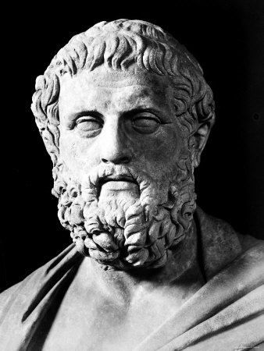
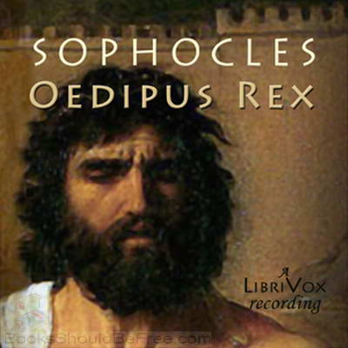
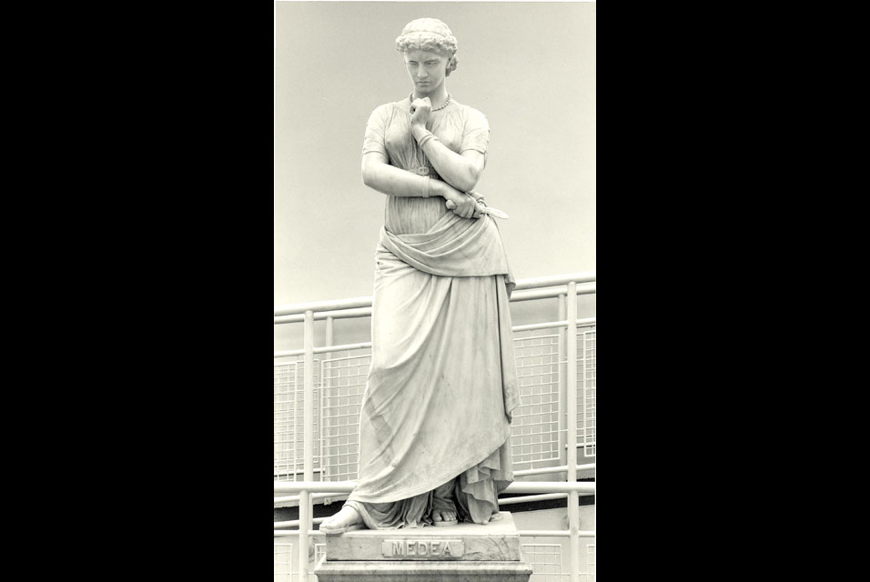
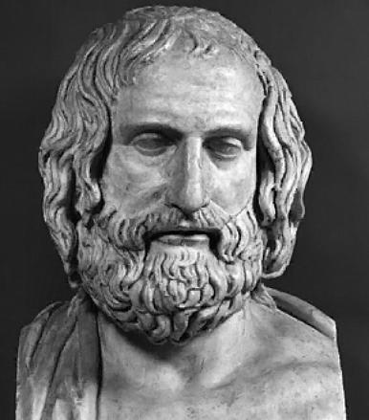

Slide 11
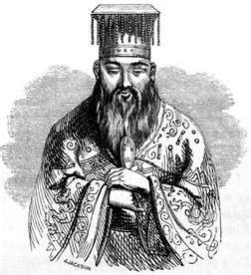
Asian Cultures: China
Confucius was born in 551 B.C.
China was in a period of great chaos:
unceasing warfare, executions of men, women, and children, corrupt politicians, moral decay
Known as the “First Teacher,” Confucius wanted to restore order. Had a political and ethical interest in philosophy, not a spiritual one
Believed that if humans acted in harmony with the universe, their affairs would prosper
Behave in accordance with the Dao (the Way): duty and humanity

Slide 12
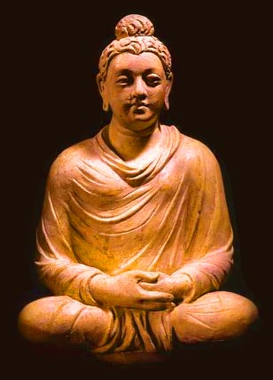
Asian Cultures: India
Siddhartha Gautama born in 536 B.C.
Became known as Buddha; no deities
Denied the reality of the physical world:
said pain, poverty, and sorrow are illusions caused by attachments of the physical world
Once people let go of these attachments, they can receive Nirvana.
No social castes/anyone could reach enlightenment; Buddhism appealed to lower classes
Monks practice a simple life and pursue wisdom.

Slide 13
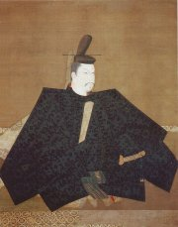
Asian Cultures: Japan
Ruled by shogunates , centralized
government ruled by powerful
military leaders called shoguns
Men and women were equal
Worshipped spirits called kami who they believed resided in trees, rivers, streams, and mountains
Believed the spirits of ancestors were present all around them

Slide 14
The New World: Native Americans
Tribes formed based on geographic location
Believed the natural world was full of spirits
Past generations remained alive to help the living
Every object, both living and nonliving, possessed a voice that might be heard if one listened closely.
Some cultures believed in a supreme being known as the “Great Spirit,” “Great Mystery,” or “the Creator.”

Slide 15
Emerging Monotheistic Religions
Religion | Islam | Judaism | Christianity
Founding Father | Abraham | Abraham | Abraham
Deity | Allah | Yahweh | God/Holy Trinity
Prophet | Mohammed | Moses | Multiple in both Old and New Testaments
Text | Quran or Koran | Torah | Bible
Basic beliefs | Accept prophets of Judaism and Christianity; Five Pillars: prayer, pilgrimage, fasting, charity, belief in Allah | The first monotheistic religion , God rewards good and punishes evil, the Messiah will come | Faith in Jesus saves believers from penalty for sin and grants eternal life

